Slide 1
Design Pattern
Term Project

Slide 2
What is Jsoup?
Overview
What we did
Test & Result
INDEX
Design Pattern

Slide 3

What is Jsoup?
STRONG HTML PARSER
Open Source Library of JAVA
Strong Html Parser
Html → DOM (Document Object Model)
Design Pattern Term project

Slide 4
What is Jsoup?
STRONG HTML PARSER
Resp onse
Docu ment
Components
(Class name)
Jsoup
Connection
Elem ent
Elem ents
Design Pattern Term project

Slide 5
What is Jsoup?
Overview
What we did
Test & Result
INDEX
Design Pattern

Slide 6
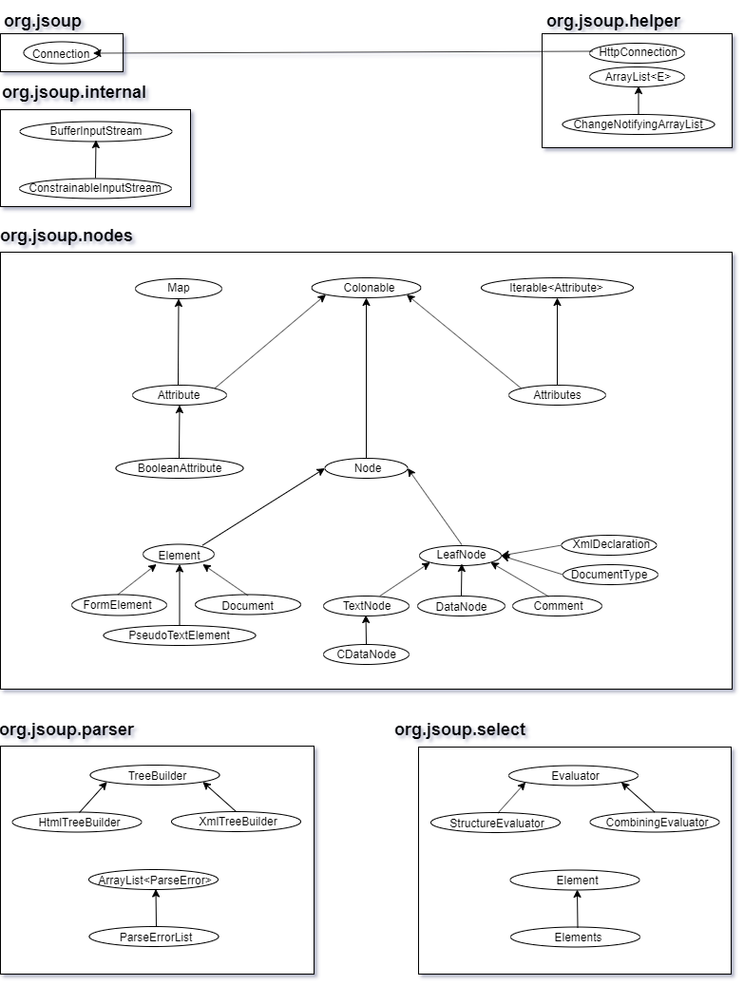
Overview
STRONG HTML PARSER
Packages
Design Pattern Term project

Slide 7
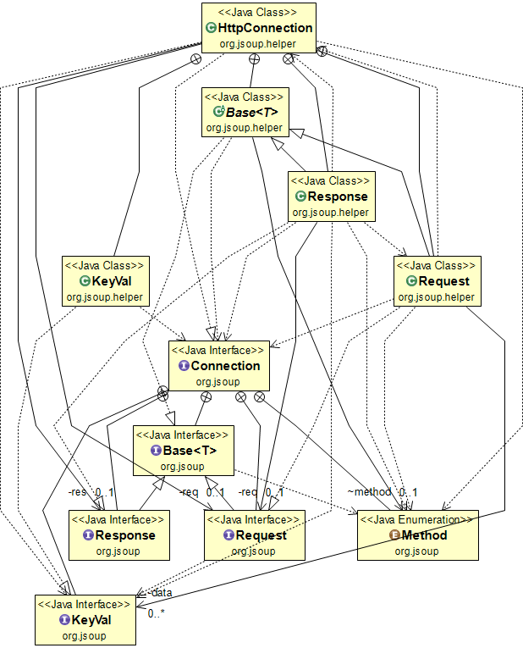
Overview
STRONG HTML PARSER
Http
Connection
Design Pattern Term project

Slide 8
Overview
STRONG HTML PARSER
Problem Check
It can read only String type.
It can’t read if URL is not complete.
We fixed these !
Design Pattern Term project

Slide 9
What is Jsoup?
Overview
What we did
Test & Result
INDEX
Design Pattern

Slide 10
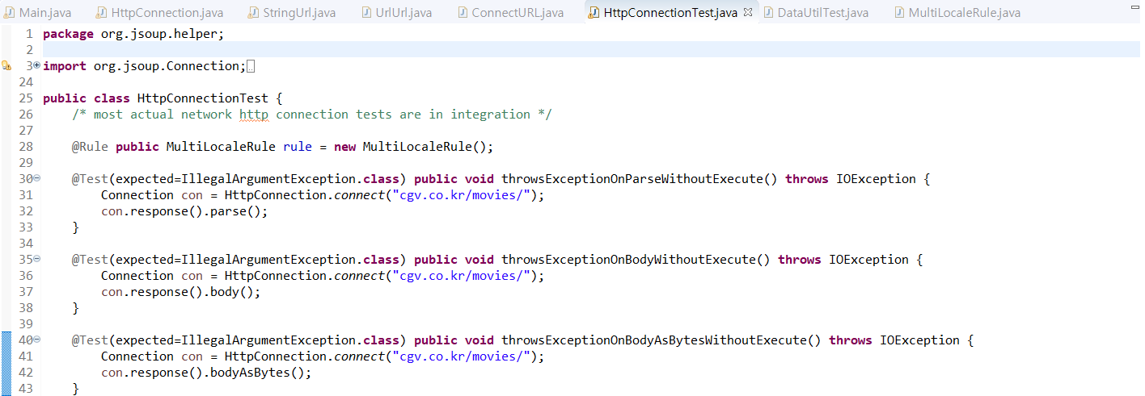
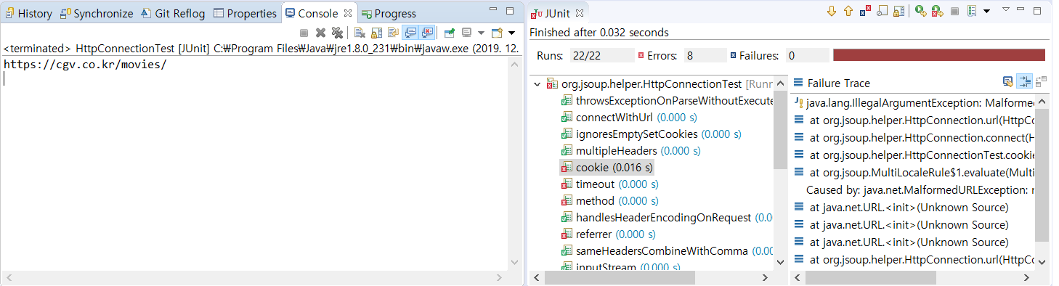
What we did
STRONG HTML PARSER
Before change
Design Pattern Term project

Slide 11
What we did
STRONG HTML PARSER
What we changed
It can read both string type and url type.
It can read though URL is not complete.
Design Pattern Term project

Slide 12
What we did
STRONG HTML PARSER
It can read both string type and url type.
HttpConnection
URL type
(Class)
UrlURL
case
(Interface) ConnectURL
String Type
(Class) StringURL
Design Pattern Term project

Slide 13
What we did
STRONG HTML PARSER
What we changed
It can read both string type and url type.
It can read though URL is not complete.
Design Pattern Term project

Slide 14
What we did
STRONG HTML PARSER
It can read though URL is not complete.
HttpConnection
URL type
(Class)
UrlURL
case
(Interface) ConnectURL
String Type
(Class) StringURL
(Extended Function)
Fix protocol
Design Pattern Term project

Slide 15
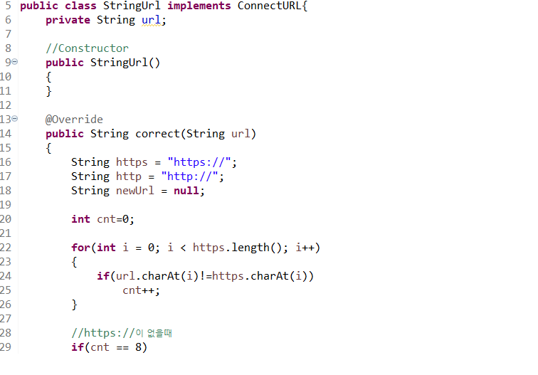
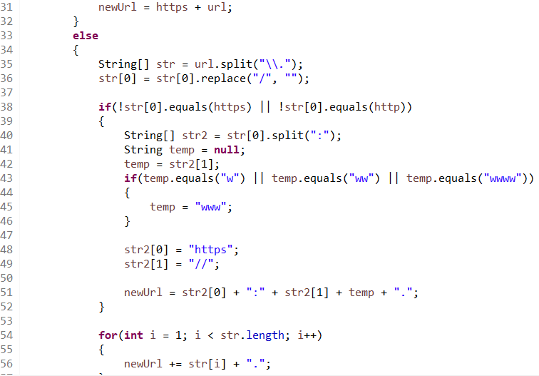
What we did
STRONG HTML PARSER
StringURL Class
Design Pattern Term project

Slide 16
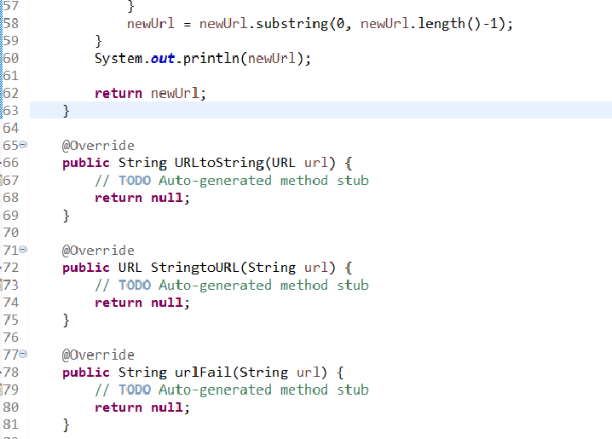
What we did
STRONG HTML PARSER
StringURL Class
Design Pattern Term project

Slide 17
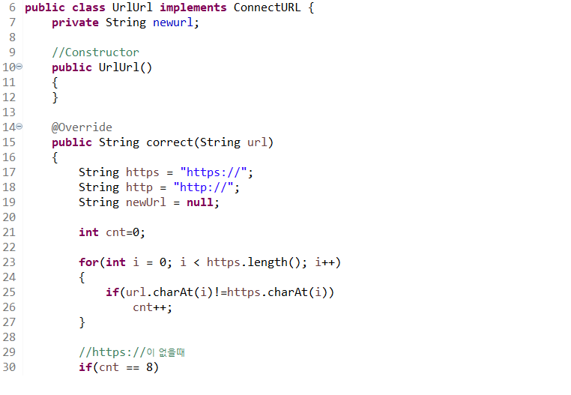
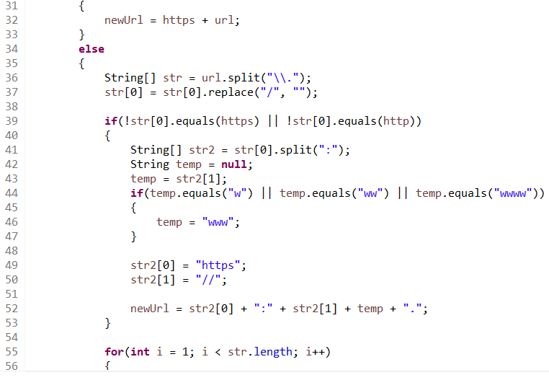
What we did
STRONG HTML PARSER
UrlURL Class
Design Pattern Term project

Slide 18
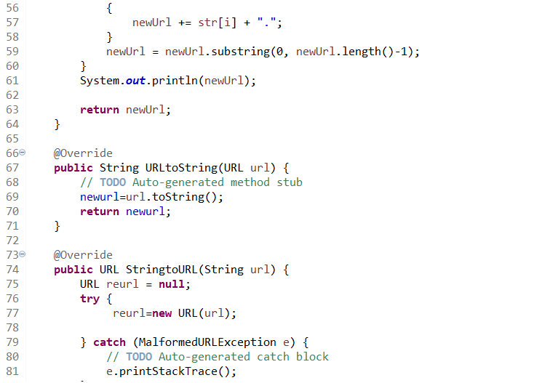
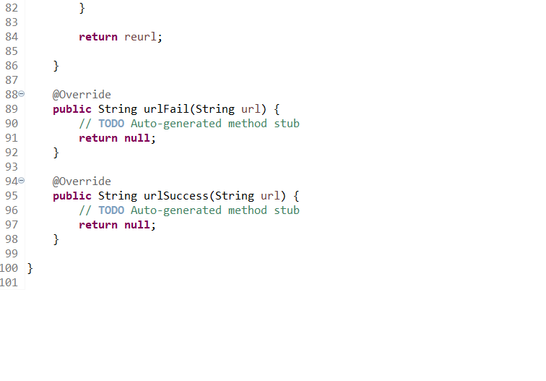
What we did
STRONG HTML PARSER
UrlURL Class
Design Pattern Term project

Slide 19
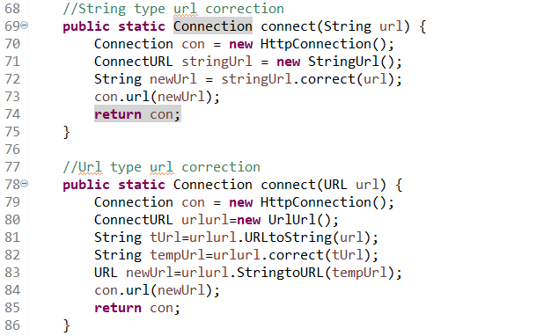
What we did
STRONG HTML PARSER
HttpConnection Class
Design Pattern Term project

Slide 20
What is Jsoup?
Overview
What we did
Test & Result
INDEX
Design Pattern

Slide 21
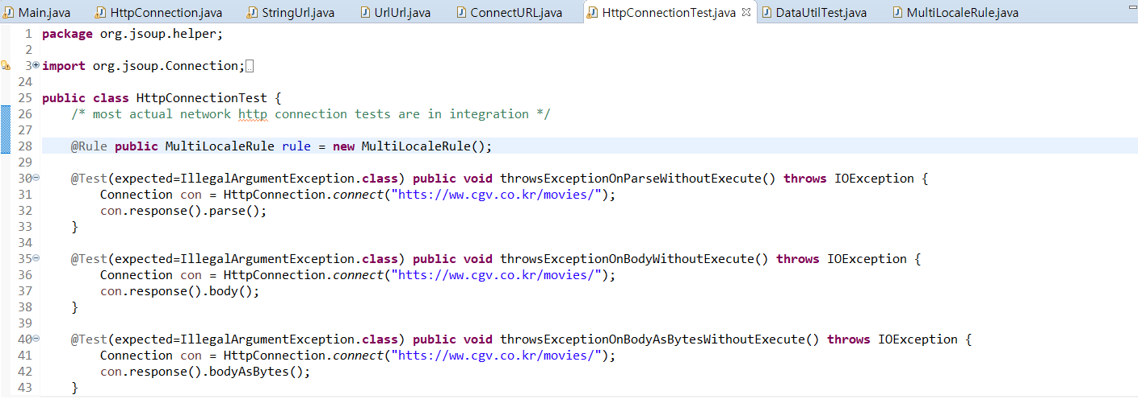
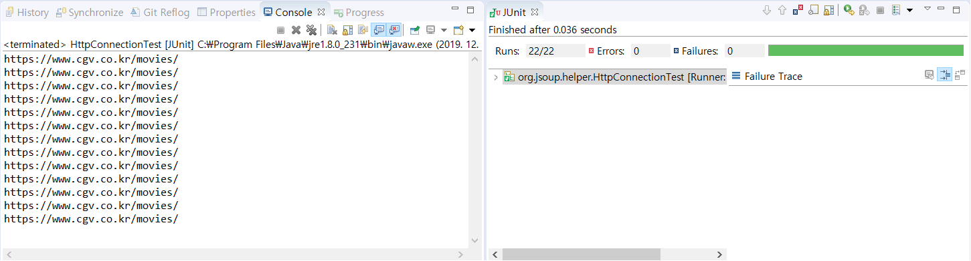
Test & Result
STRONG HTML PARSER
Test case
Wrong host name
Wrong protocol
Design Pattern Term project

Slide 22
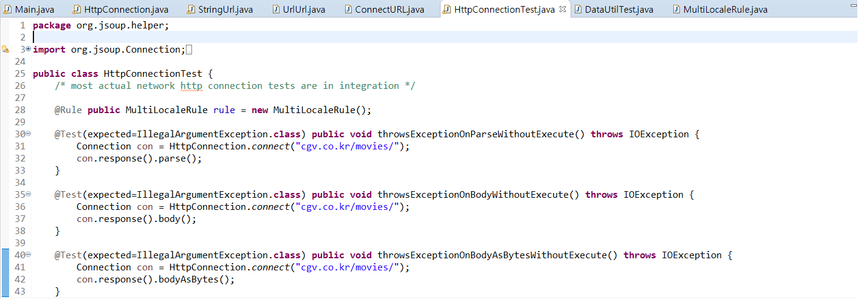
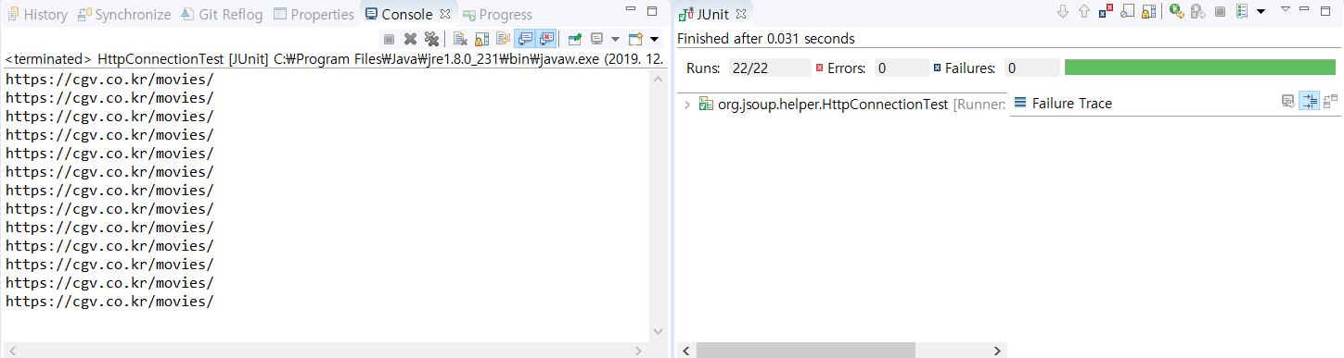
Test & Result
STRONG HTML PARSER
Test case
Wrong host name
Wrong protocol
Design Pattern Term project

Slide 23
Thank you
Design Pattern Term Project

